Slide 1

Guidance Teacher: Mohd Naved Qureshi
Team Members-
Salim Ansari
Mohd Usman
Shadab Ahmad
Mohd Zubair Qamar

Slide 2

Contents
Introduction
Need of Home Automation
Hardware Used
Block Diagram
Circuit Diagram
Software Used
Android App Designed for the Project
Its Future Advancement
Skills We Use
Reference

Slide 3

Introduction
Home automation is the control of any or all electrical devices in our home or office, whether we are there or away. It is one of the most exciting developments in technology for the home that has come along in decades.
Home automation may include centralized control of
lighting, HVAC (heating, ventilation and air conditioning), appliances, and other systems, to provide improved convenience, comfort, energy
efficiency and security.

Slide 4
Need of Automation System
An automated device can replace good amount of human working force, and can work with diligence, versatility and with almost zero error.
Replacing human operators in tasks that involve hard
physical or monotonous work.
Replacing humans in tasks done in dangerous environments (i.e. fire, space, volcanoes, nuclear facilities, underwater, etc.)
Performing tasks that are beyond human capabilities of size, weight, speed, endurance, etc.

Slide 5
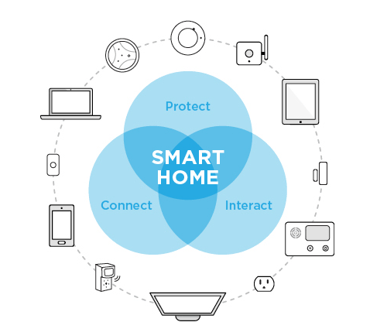
Hardware Used
Arduino UNO.
Relays Module
Bluetooth Module HC-05
Wifi Module ESP8266
Bread Board
Connecting Wire
LED Bulb
Android Smart phone
Computer

Slide 6

1.Arduino UNO
Arduino is an open-source, programmable microcontroller and software based on the AT Mega chip (datasheet).
The Arduino board can be programmed using the Arduino software. The syntax for this is similar to C/C++ and Java.
The ATmega328 is a single-chip microcontroller
created by Atmel in the megaAVR family.

Slide 7
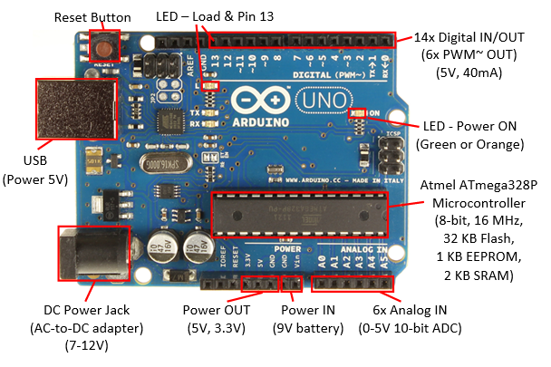

Slide 8
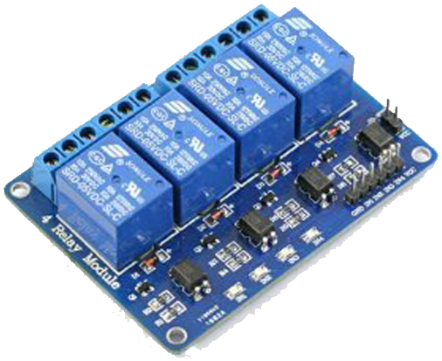
2. Relay Module
A relay is an electrically operated switch.
Relays are used to control a high power (230v) by low power (5v-12v).
A relay is an electromagnetic switch operated by a relatively small electric current that can turn on or off a much larger electric current. The heart of a relay is an electromagnet (a coil of wire that becomes a temporary magnet when electricity flows through it)
Relays work on electromagnetism, When the Relay coil is energized it acts like a magnet and changes the position of a switch.

Slide 9
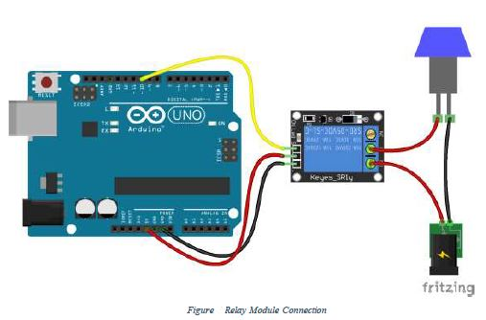
Relay Connection

Slide 10
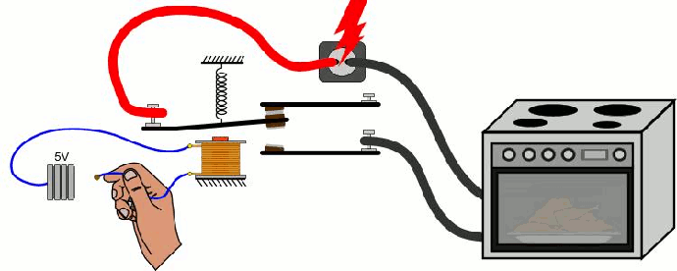
Working of Relay

Slide 11
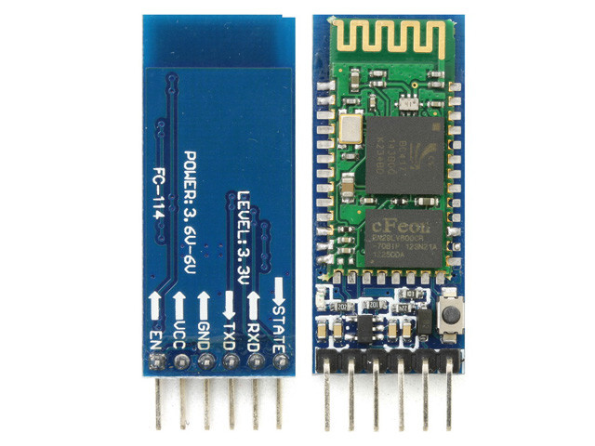
3. Bluetooth Module HC-05
HC – 05 is a Bluetooth module, which is used for create a connection between two Bluetooth devices, it gets supplied from the Arduino chip and also give instruction to Arduino chip.
HC-05 module is an easy to use Bluetooth SPP (Serial Port Protocol) module, designed for transparent wireless serial connection setup.
Bluetooth is a wireless technology standard for exchanging data over short distances (using short-wavelength UHF radio waves in the ISM band from 2.4 to 2.485 GHz) from fixed and mobile devices, and building personal area networks (PANs).
Range is approximately 10 Meters (30 feet)

Slide 12
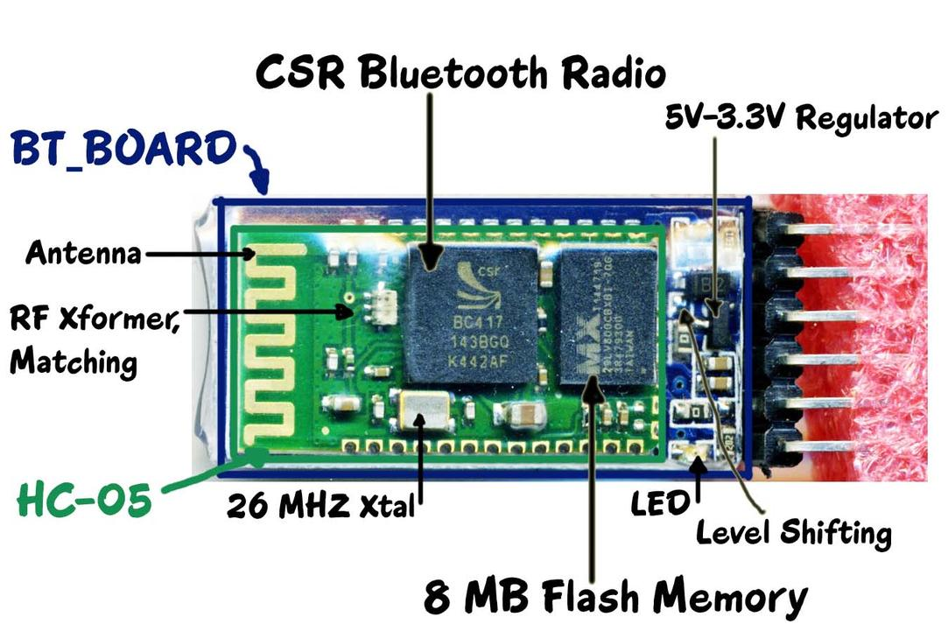

Slide 13
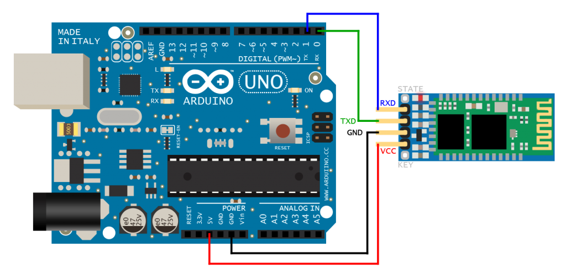

Slide 14
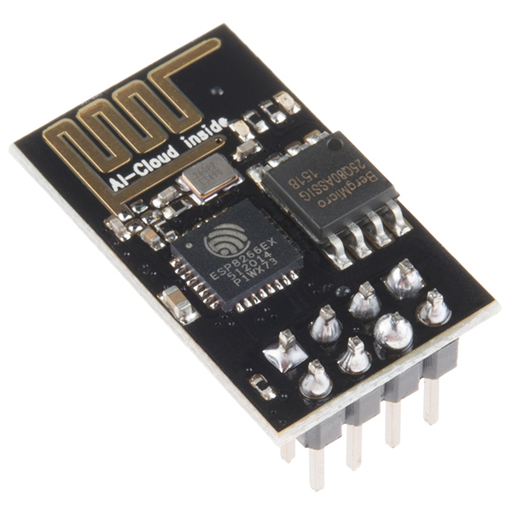
4. Wifi Module ESP-8266
The ESP8266 is a low-cost Wi-Fi chip with full TCP/IP stack and MCU (microcontroller unit) capability.
The chip first came to the attention of western makers in August 2014 with the ESP-01 module.
This small module allows microcontrollers to connect to a Wi-Fi network and make simple TC
The ESP8266 with 1 MiB of built-in flash, allowing for single-chip devices capable of connecting to Wi-Fi.P/IP connections.
The mebibyte (MiB) is a multiple of the unit byte for digital information.

Slide 15
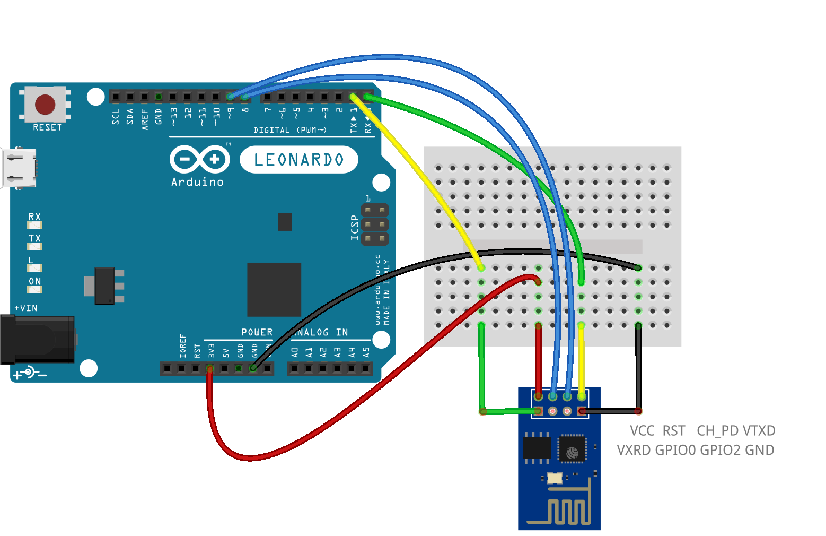
Connect Wifi Module to Arduino

Slide 16
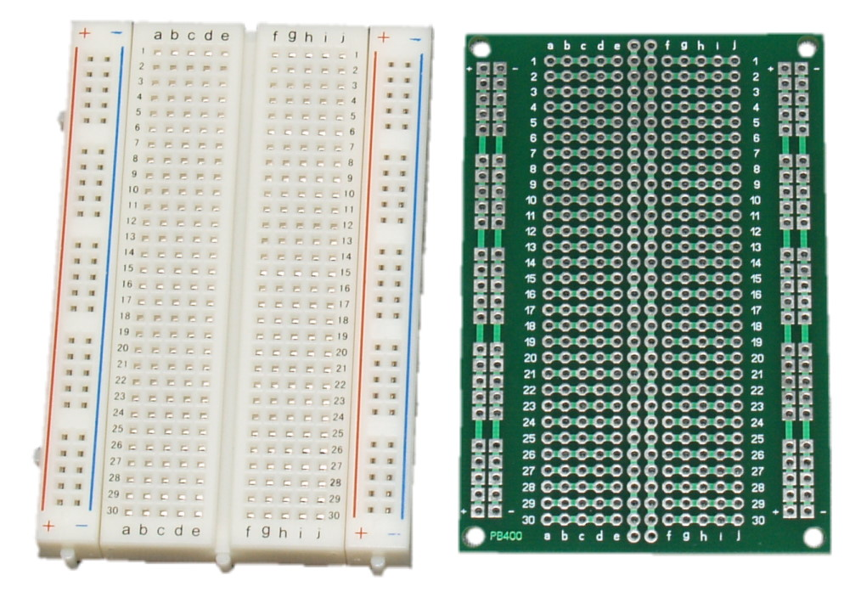
5. Bread Board

Slide 17
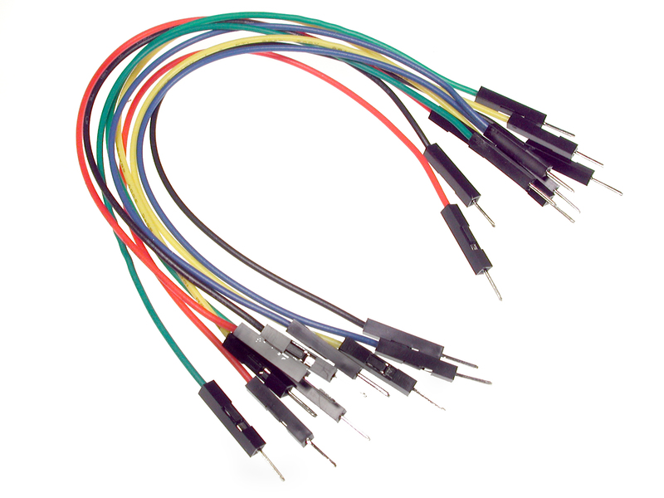
6. Connecting Wire

Slide 18
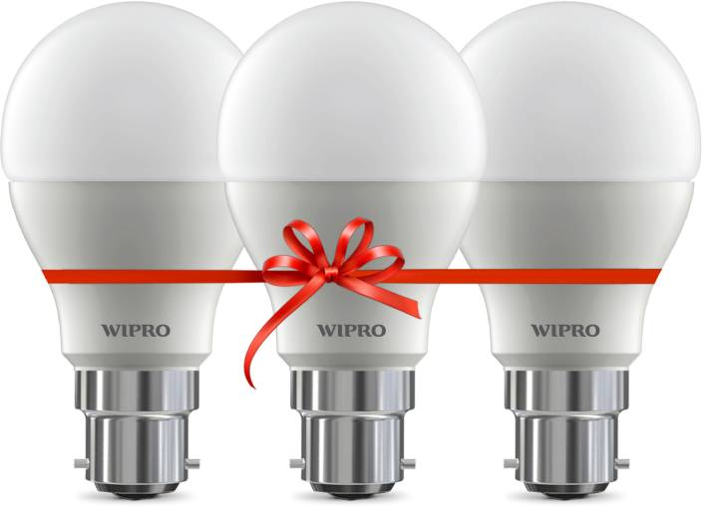
7. LED Bulb

Slide 19
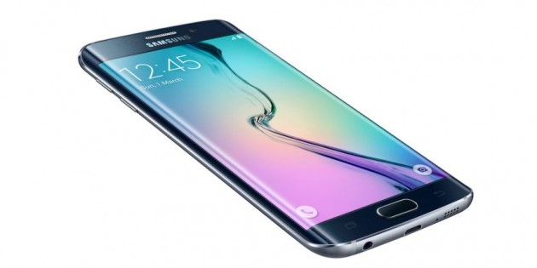
8. Android Phone

Slide 20
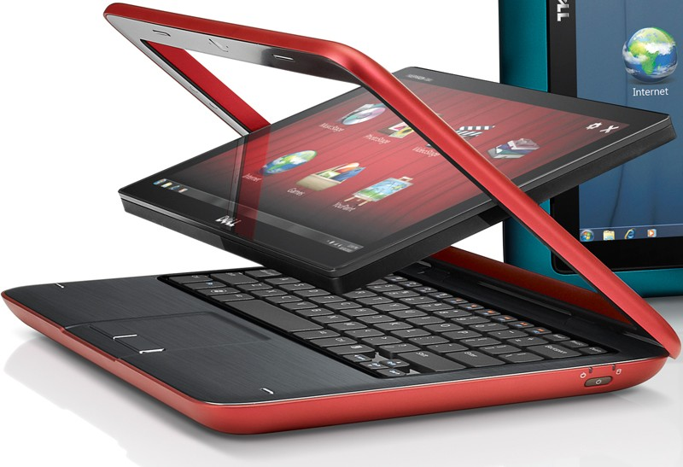
9. Computer

Slide 21
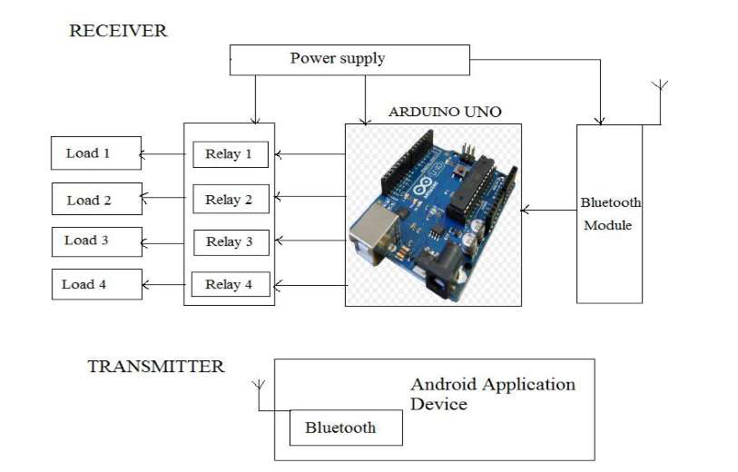
Block Diagram

Slide 22
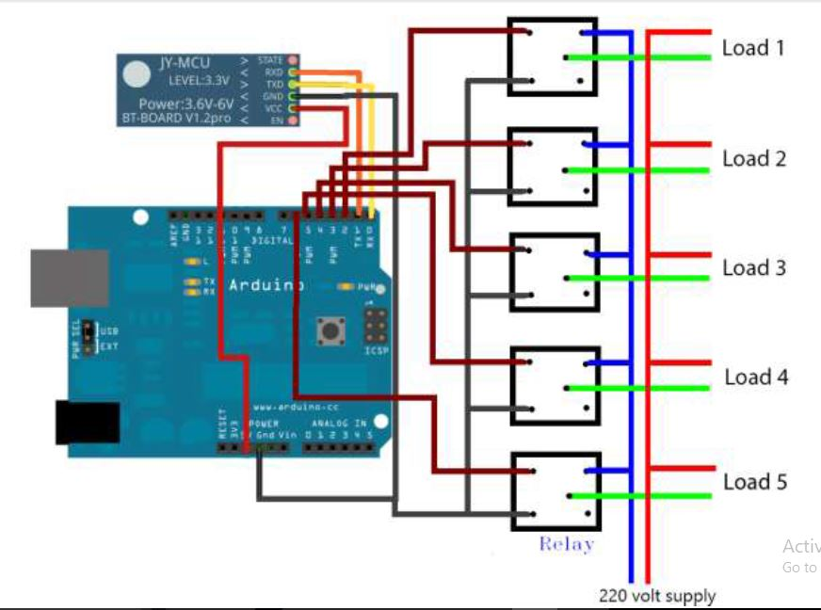
Circuit Diagram

Slide 23

Software Used
1. Arduino IDE (Integrated Development Environment )-
IDE software used to upload program in Arduino.
2. Photoshop-
Photoshop is used to design android app icon.
3. Emulator-
Emulator used to see the view of android app.

Slide 24
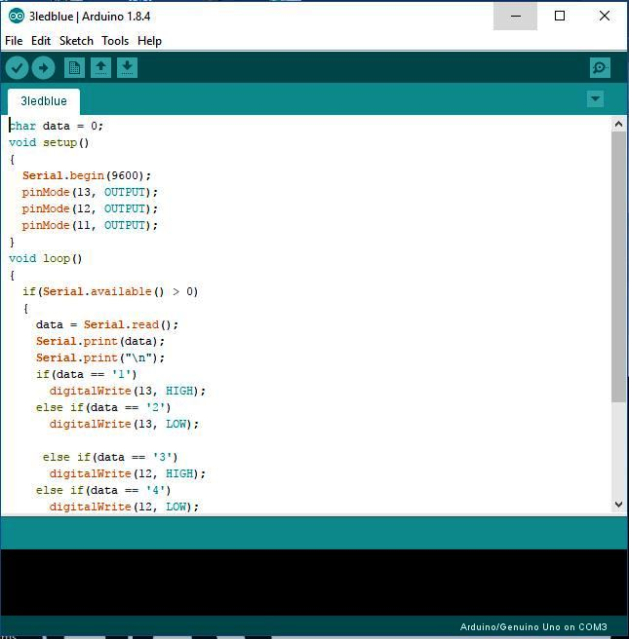
1. Arduino IDE (Integrated Development Environment )-

Slide 25
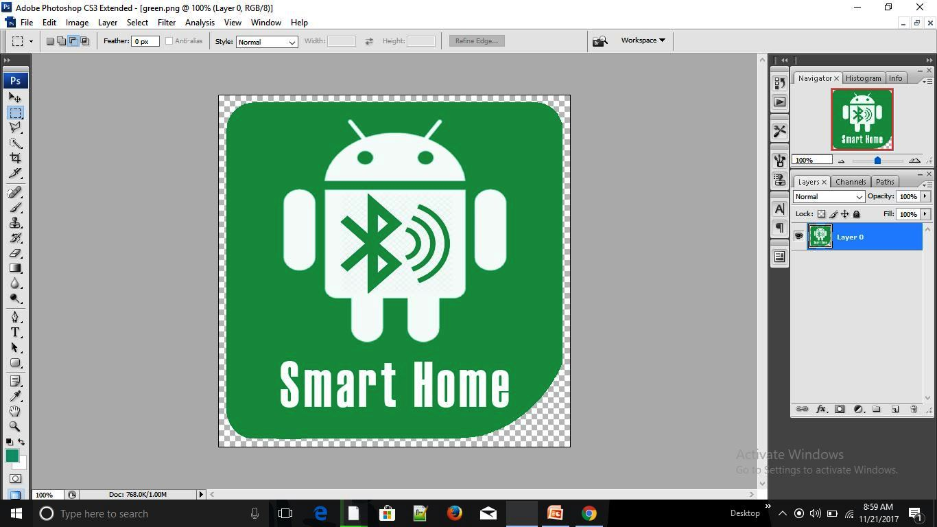
2.Photoshop-

Slide 26
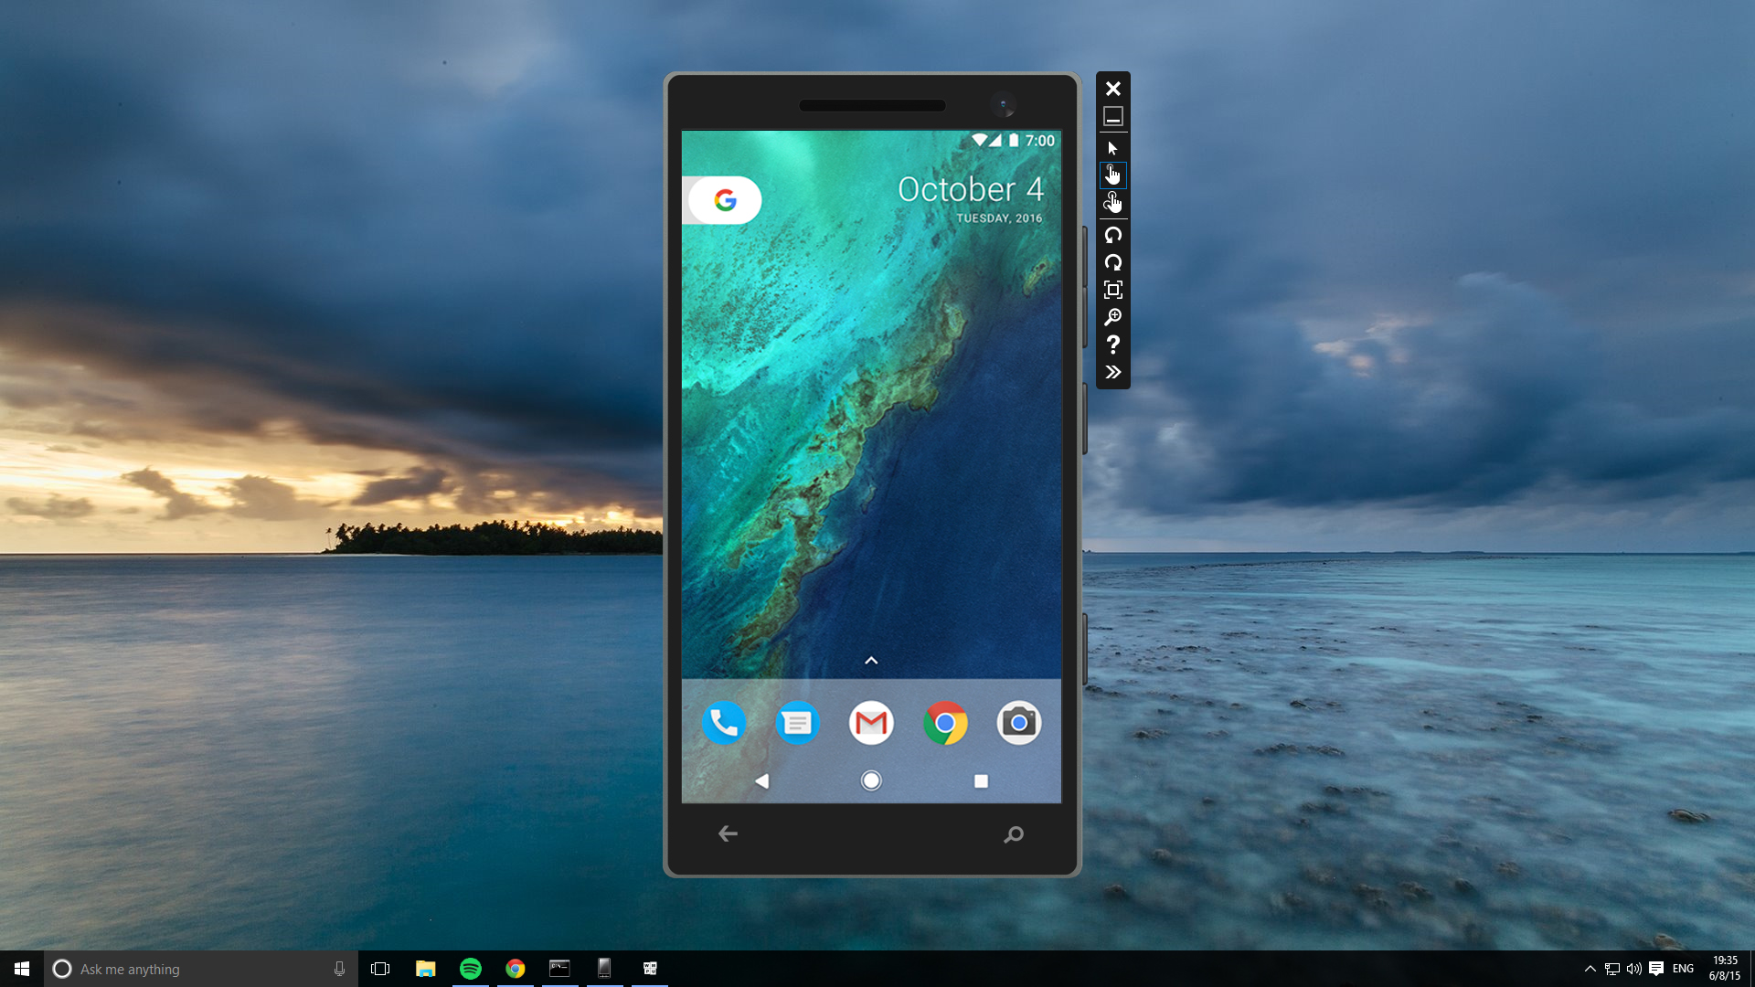
3. Emulator

Slide 27

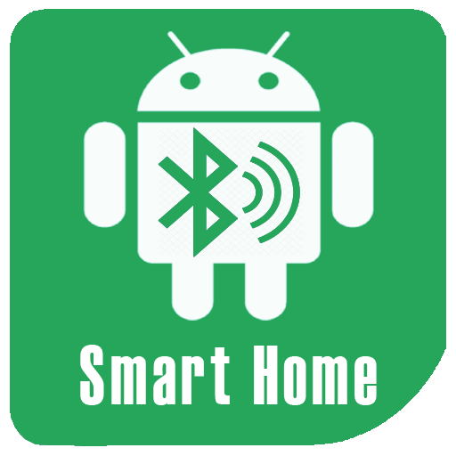
Android App Design for the Project
Arduino Bluetooth Controller (APK).
Arduino Wifi Controller(APK)

Slide 28
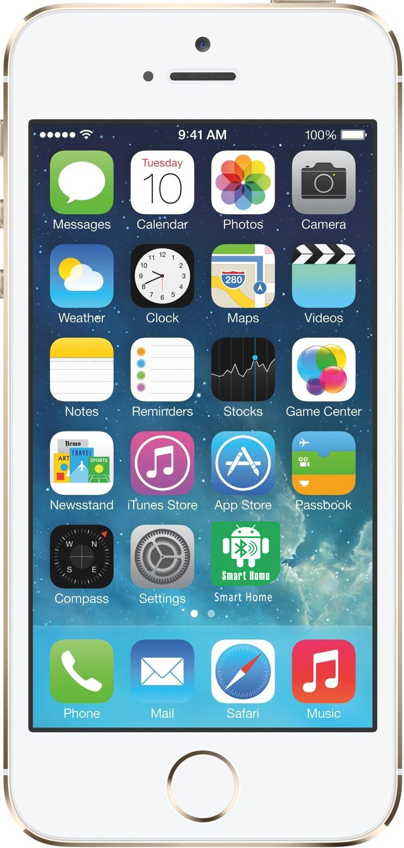
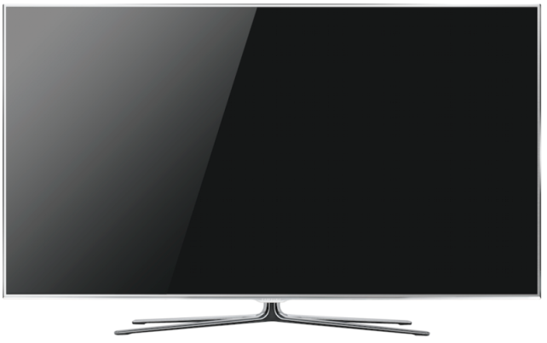
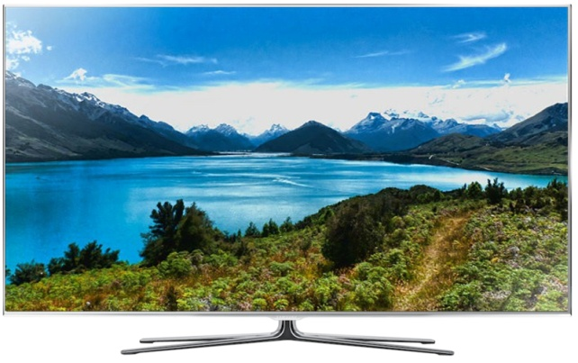
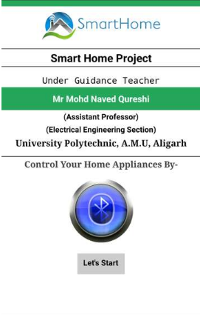
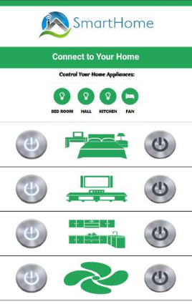


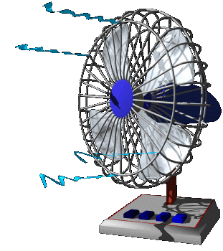
1. Arduino Bluetooth Controller APK

Slide 29
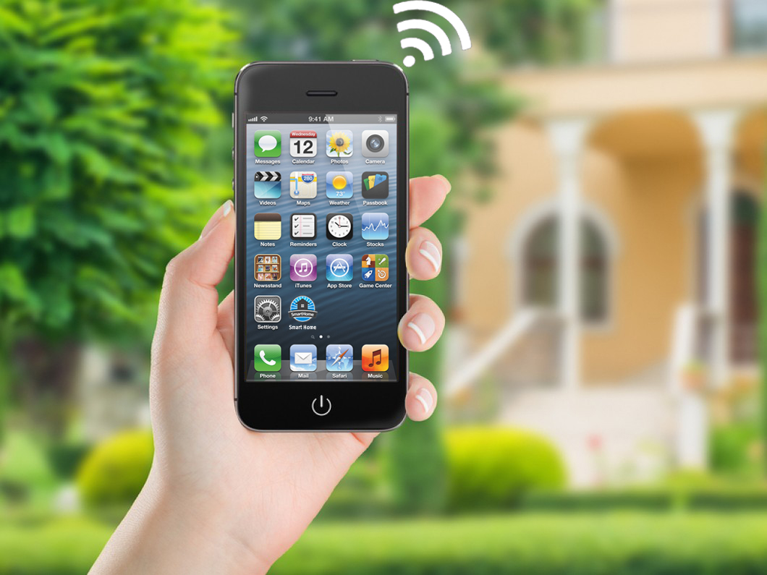
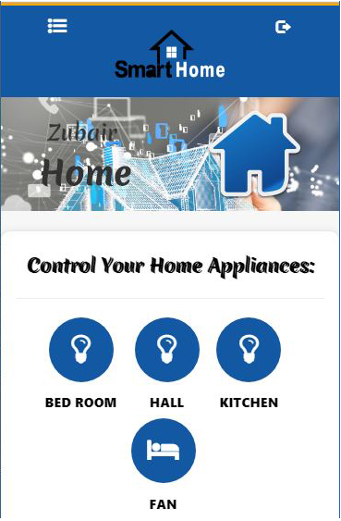
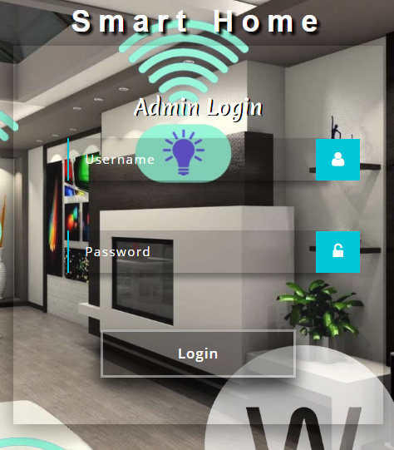
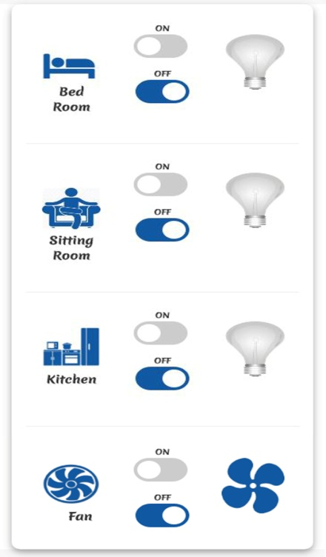
2. Arduino Wifi Controller APK

Slide 30


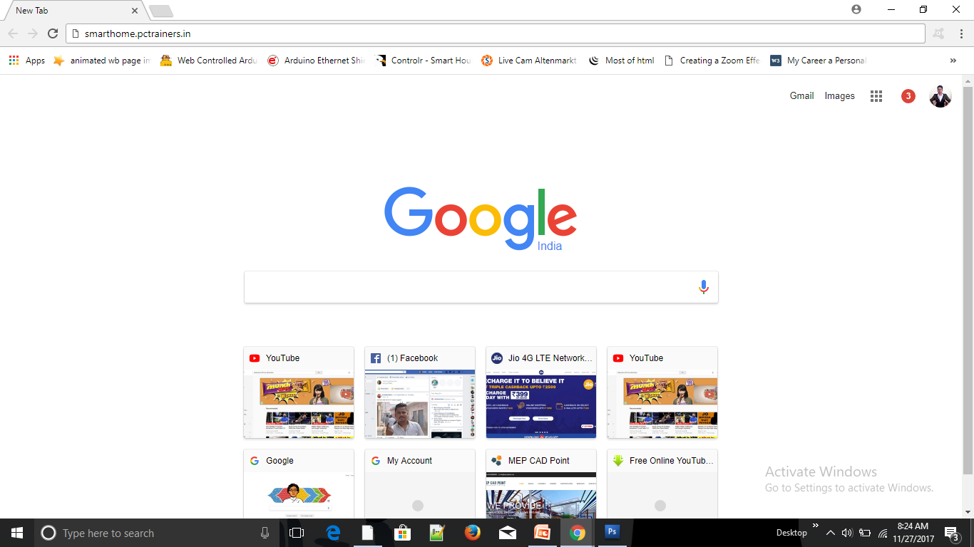
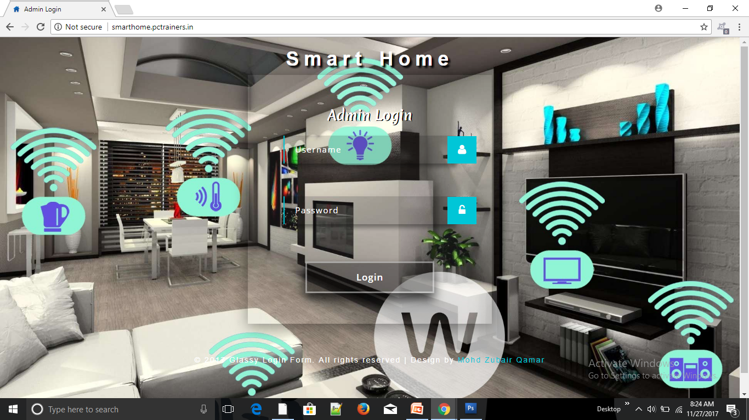
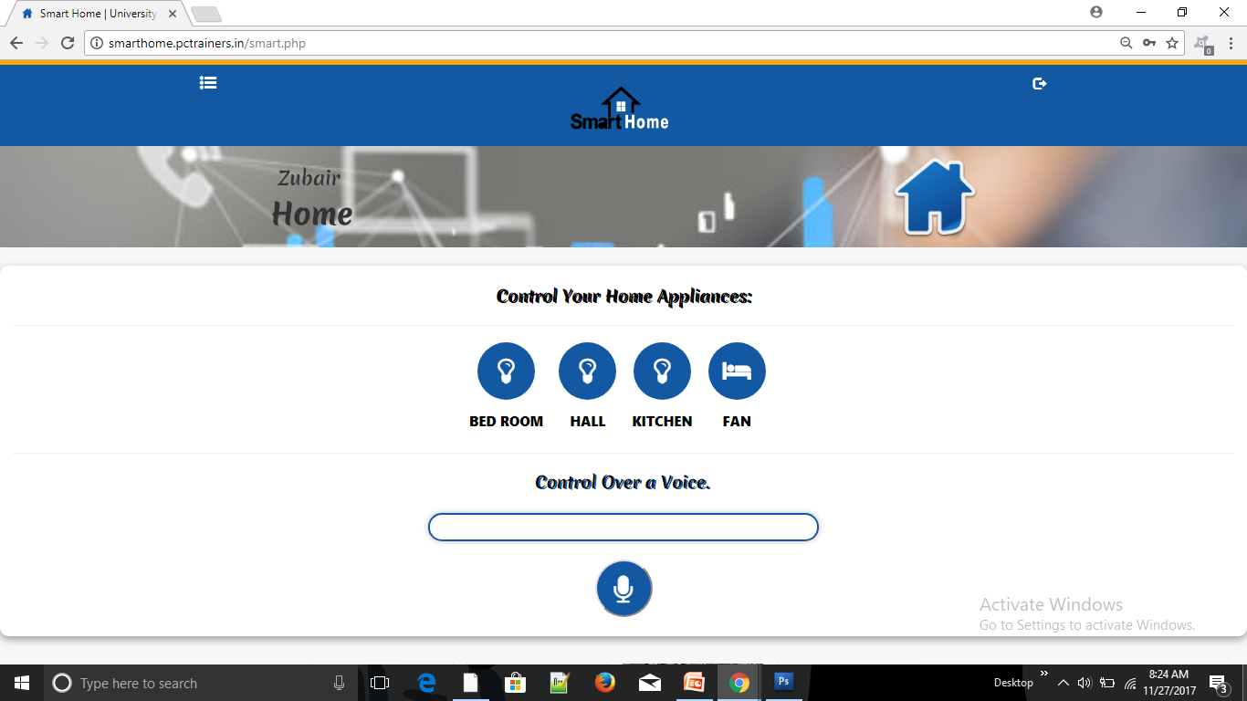
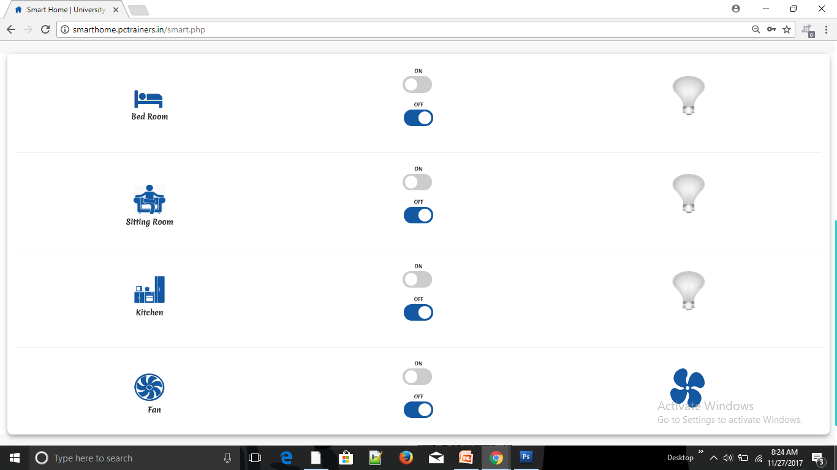
www.smarthome.pctrainers.in

Slide 31
Its Future Advancement
A person enter in a room the LED Bulb and Fan is automatically ON/OFF.
Secure you home by unknown person.
Control your home appliances through voice.
We use android phone as webcam.
And, add some more extra feature.

Slide 32
Skills We Use
Hardware
Programming
Android APP Development
Web Designing & Development
Work on Live Server & Database.

Slide 33

Reference
www.google.co.in
www.wikipedia.org
www.youtube.com
www.arduino.cc

Slide 34
THANK YOU

